Slide 1



Course freak
.Your academic assistant

Slide 2


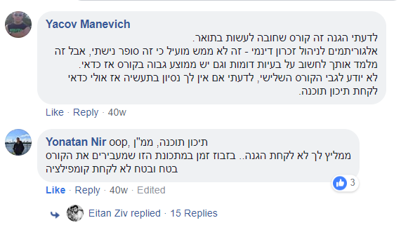
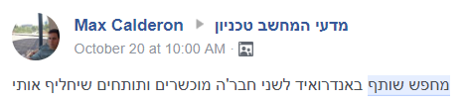
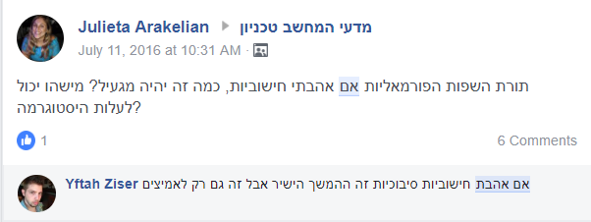

Our problem:
Distributed,
unorganized,
inaccessible & out-of-date information.

Slide 3



Our Users:
Technion CS students, staff members and guests.
Our Solution:
A unified platform for all
course-related tasks in an interactive environment, just a finger click away.
Improved quality of data achieved by using our ‘HiveMind’ architecture.
Course matching using our ML Recommender engine.

Slide 4

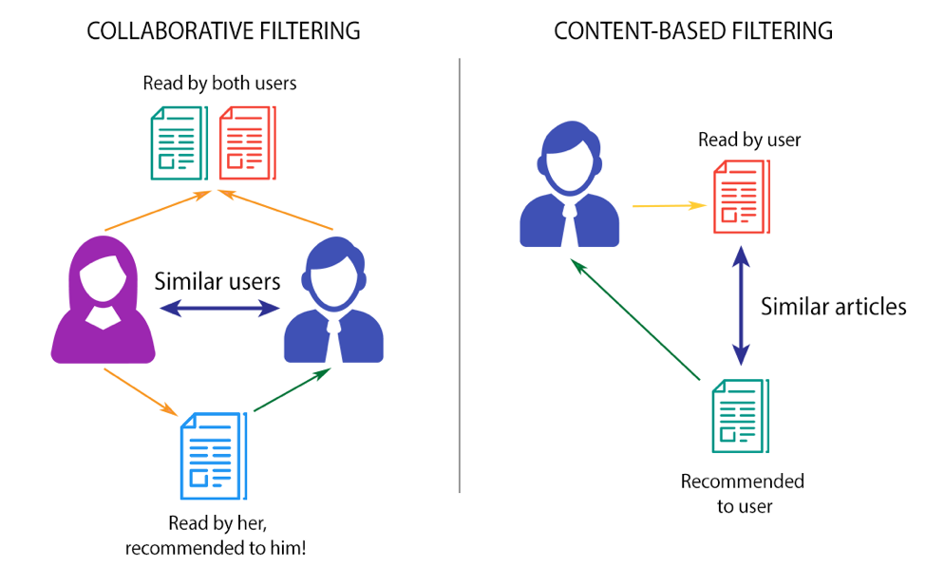
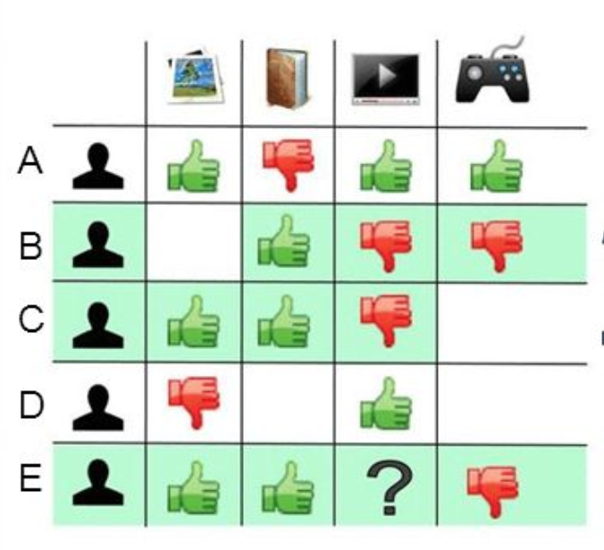

C f
HiveMind
We keep all past years students’ reviews and ratings to use the wisdom of crowds.
We continuously collect up-to-date data and filter it for you by your interests and needs.
We use students’ feedback to show you only the most relevant reviews.
We use advanced ML algorithms to give you the best recommendations for courses you might like.

Slide 5



Course freak App
Interactive, Android based UI that allows you to :
Be a part of the mind hive
Share your experience with other students.
Write reviews & give feedback to others.
Play our interactive game and win honey jars
while helping us improve our data accuracy.
With us, your opinion really makes a difference.
Always stay alert
Let our smart engine let you know when new opportunities arise.
When your friends are looking for partners or are interested in a course, you’ll be the first to know.
With us, you will never miss a chance.
Time to make decisions?
Let our sophisticated machines
do all the work for you.
Rank a few courses you already took,
sit back and let our app show you your future.
Our background algorithm will find
students with taste like yours.
With us, you will never need to take advice from a מצטיין נשיא.
Course freak

Slide 6






Our Team
Roy Hirsch
Amit Sdeor
Denis Nastic
UI & Cloud Infrastructures expert
Big Data & Machine Learning expert
End-to-End Android expert

Slide 7

Questions?

Slide 8
User Stories

Slide 9
“As a user I want to get recommendations for courses that might interest me”
Time Estimation: 6 hours
Owner: Amit Sdeor
Frameworks: Firebase, JML or LAML, Android Studio
Risks: Recommendation engine will take time to train well.

Slide 10
“As a user I want to get relevant recommendations for my potential courses only (are in my Catalog and fit my requirements and didnt take yet)”
Time Estimation: 3 hour
Owner: Amit Sdeor
Frameworks: Firebase, Android Studio
Risks: None.

Slide 11
“As a user I want to contribute and provide my personal ratings to help the app give me more accurate recommendations.”
Time Estimation: 2 hour
Owner: Amit Sdeor
Frameworks: Firebase, Android Studio
Risks: Users may not want to spend time providing ratings.

Slide 12
“As a guest I would like to see course ratings without having to log in.”
Time Estimation: 3 hours
Owner: Amit Sdeor
Frameworks: Firebase, Android Studio
Risks: None.

Slide 13
“As a user I want to contribute and provide my personal ratings to help the app give me more accurate recommendations.”
Time Estimation: 1 hour
Owner: Amit Sdeor
Frameworks: Firebase, Android Studio
Risks: Users may not want to spend time providing ratings.

Slide 14
“As a guest I would like to see if a course I'm considering is being talked about a lot, so I might sign up to get more informed about it.”
Time Estimation: 3 hours
Owner: Amit Sdeor
Frameworks: Firebase, Android Studio
Risks: None.

Slide 15
“As a user I want to see the data about a course as it is shown in the UG website.” (nice-to-have)
Time Estimation: 2 hours
Owner: Amit Sdeor
Frameworks: Python, javascript
Risks: Depends on the UG website being available.

Slide 16
“As a user I want to get extra course info and be able to filter it by different categories, so that I will have all the information needed to decide.”
Time Estimation: 4 hours
Owner: Amit
Frameworks: Firebase, Android Studio
Risks: Data entry might require serious manual work, depends on external sources

Slide 17
“As a user I want to contact easily a student who has published a review so that I could ask them any follow up questions.”
Time Estimation: 1 hour
Owner: Amit
Frameworks: Firebase, Android Studio
Risks: Users will refuse to provide contact information

Slide 18
“As a user I want to read reviews for courses, and I want to see the most popular reviews first”
Time Estimation: 3 hours for Android activity, 2 hours for resources.
Owner: Roy Hirsch
Frameworks: Firebase & Android Studio
Risks: None.

Slide 19
“As a user I want to give feedback for other students' reviews (anonymously) so that other users (and myself) will see less irrelevant reviews.”
Time Estimation: 2 hours for the Android activity.
Owner: Roy Hirsch
Frameworks: Firebase & Android Studio
Risks: None.

Slide 20
“As a user I want to write reviews for courses I took (anonymously/identified)”
Time Estimation: 2.5 hours for front-end, 1 hour for back-end.
Owner: Roy Hirsch
Frameworks: Firebase & Android Studio
Risks: None.

Slide 21
“As a user I want to be able to update any inaccurate/outdated info shown for courses listed on the app”
Time Estimation: 3 hours for front-end, 2 hour for back-end.
Owner: Roy Hirsch
Frameworks: Firebase & Android Studio
Risks: None.

Slide 22
“As a user I want to get notifications when interesting things happen - my friends are looking for partners, my partner suggestion was accepted/rejected, or if the system found me new matches.”
Time Estimation: 5 hours.
Owner: Roy Hirsch
Frameworks: Firebase
Risks: None.

Slide 23
“As a user I want to see my match ratio for a certain course.”
Time Estimation: 4 hours.
Owner: Roy Hirsch
Frameworks: Firebase, Android Studio
Risks: None.

Slide 24
“As a user I want to interactively rate (Like/Dislike) courses and I would like the experience to be good and fun- short,interactive,rewarding. So that I will be happy contributing data without spending too much of my time.”
Time Estimation: 9 hours.
Owner: Roy Hirsch
Frameworks: Firebase, Android Studio, Animation/GUI library
Risks: None.

Slide 25
“As a user I want to see who is looking for a partner in a certain course & mark that I am looking for one & actively initiate a partner request.”
Time Estimation: 9 hours.
Owner: Denis Nastic.
Frameworks: Firebase, Android Studio, Animation/GUI library
Risks: None.

Slide 26
“As a user I want to mark potential courses I am considering on taking next semester so that my friends will know.”
Time Estimation: 6 hours.
Owner: Denis Nastic.
Frameworks: Firebase, Android Studio, Animation/GUI library
Risks: None.

Slide 27
“As a user I want to report a problem in the system or the data, and to make improvement suggestions..”
Time Estimation: 3 hours.
Owner: Denis Nastic.
Frameworks: Firebase, Android Studio
Risks: None.

Slide 28
“As a user I want to follow-up an existing review (add questions/corrections) so that other users might also get an answer if my question seems common.”
Time Estimation: 5 hours.
Owner: Denis Nastic.
Frameworks: Firebase, Android Studio
Risks: None.

Slide 29
“As a user I want to see the content in my preferred language (Hebrew,English).”
Time Estimation: 3 hours.
Owner: Denis Nastic.
Frameworks: Android Studio, App language management framework.
Risks: None.

Slide 30
“As a user I want to get the app's content in my language(Arabic,Russian,Spanish,French,Chinese).”
Time Estimation: 4 hours.
Owner: Denis Nastic.
Frameworks: Android Studio, App language management framework.
Risks: None.

